Slide 1
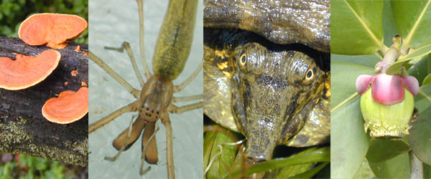
GENERAL BIOLOGY fdn 1203
Dr. Theja Abayarathna
Department of Biology
Faculty of Applied Sciences
Rajarata University of Sri Lanka

Slide 2
NUTRITION

Slide 3
Autotrophic and Heterotrophic Nutrition
Living organisms obtain chemical energy, they need to perform activities, in one of two ways.
Autotrophic
Autotrophs store chemical energy in carbohydrate food molecules they build themselves.
Food is chemical energy stored in organic molecules.
Food provides both the energy to do work and the carbon to build bodies.

Slide 4
Because most autotrophs transform sunlight to make food, we call the process they use photosynthesis.
Only three groups of organisms - plants, algae, and some bacteria - are capable of this life-giving energy transformation.
Autotrophs make food for their own use, but they make enough to support other life as well.

Slide 5
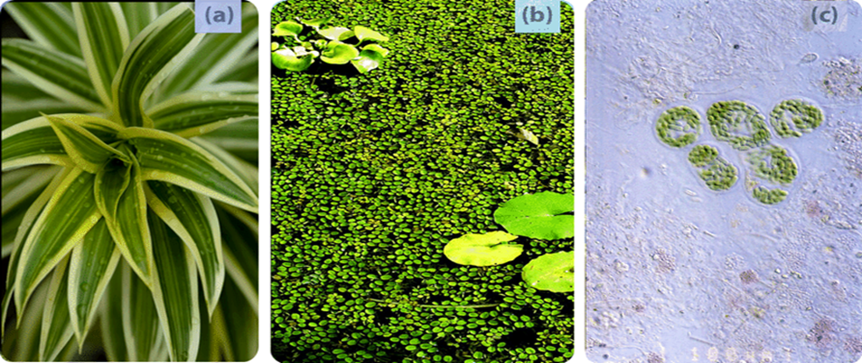
Almost all other organisms depend on these three groups for the food they produce.
The producers, as autotrophs are also known, begin food chains which feed all life.
Plants
Algae
Photosynthetic bacteria

Slide 6
Heterotrophs cannot make their own food, so they must eat or absorb it.
For this reason, heterotrophs are also known as consumers.
Consumers include all animals and fungi and many protists and bacteria.
They may consume autotrophs or other heterotrophs or organic molecules from other organisms.
Heterotrophs show great diversity but heterotrophs are limited by our utter dependence on those autotrophs that originally made our food.

Slide 7
If plants, algae, and autotrophic bacteria vanished from earth, animals, fungi, and other heterotrophs would soon disappear as well.
All life requires a constant input of energy.
Only autotrophs can transform that ultimate, solar source into the chemical energy in food that powers life.

Slide 8
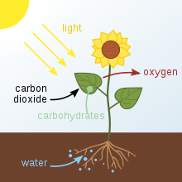
Photosynthesis
Photosynthesis is the process used by plants, algae and certain bacteria to capture energy from sunlight and turn it into chemical energy.

Slide 9
The process of Photosynthesis
There are two types of photosynthetic processes:
oxygenic photosynthesis
anoxygenic photosynthesis.
The general principles are very similar, but oxygenic photosynthesis is the most common.

Slide 10
During oxygenic photosynthesis,
light energy transfers electrons from water (H₂O) to carbon dioxide (CO₂),to produce carbohydrates.
In this transfer, the CO₂ is "reduced," or receives electrons,
and the water becomes "oxidized," or loses electrons.
Ultimately, oxygen is produced along with carbohydrates. The capturing of sunlight is done by chloroplast.

Slide 11
Anoxygenic photosynthesis does not produce oxygen hence the name is given as anoxigenic.
What is produced depends on the electron donor.
For example, many bacteria use the bad-eggs-smelling gas hydrogen sulfide, producing solid sulfur as a byproduct.
Though both are complex, multistep affairs, the overall process can be neatly summarized as a chemical equation.

Slide 12
Oxygenic photosynthesis is written as follows:
6CO₂ + 12H₂O + Light Energy → C₆H₁₂O₆ + 6O₂ + 6H₂O
Here, six molecules of carbon dioxide (CO₂) combine with 12 molecules of water (H₂O) using light energy.
The end result is the formation of a single carbohydrate molecule (C₆H₁₂O₆, or glucose) along with six molecules each of breathable oxygen and water.

Slide 13
Similarly, the various anoxygenic photosynthesis reactions can be represented as a single generalized formula:
CO₂ + 2H₂A + Light Energy → [CH₂O] + 2A + H₂O
The letter A in the equation is a variable and H₂A represents the potential electron donor. For example, A may represent sulfur in the electron donor hydrogen sulfide (H₂S).

Slide 14
Using food – Respiration
The flow of energy through living organisms begins with photosynthesis.
This process stores energy from sunlight in the chemical bonds of glucose.
By breaking the chemical bonds in glucose, cells release the stored energy and
make the ATP they need.
The process in which glucose is broken down and ATP is made is called cellular respiration

Slide 15
Photosynthesis and cellular respiration are like two sides of the same coin.
The products of one process are the reactants of the other.
Together, the two processes store and release energy in living organisms.
The two processes also work together to recycle oxygen in Earth’s atmosphere.

Slide 16
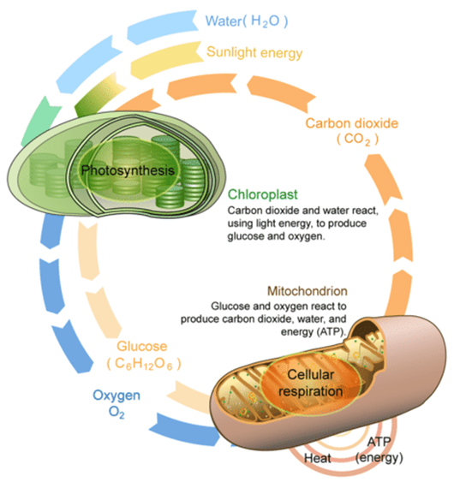

Slide 17
Cellular Respiration
Cellular respiration actually “burns” glucose for energy.
This is because it releases the energy in glucose slowly, in many small steps.
It uses the energy that is released to form molecules of ATP.
Cellular respiration involves many chemical reactions, which can be summed up with this chemical equation:
C₆H₁₂O₆ + 6O₂ → 6CO₂ + 6H₂O + Chemical Energy (in ATP)
Cellular respiration occurs in the cells of all living things. It takes place in the cells of both autotrophs and heterotrophs.

Slide 18
Reproduction
Organisms reproduce to pass on their genes and create new members of their species.
If the organisms of a species all fail to reproduce then the species may become extinct.
2 modes of reproduction
Asexual and Sexual.

Slide 19
Asexual Reproduction
Does not need the union of sex cells or gametes.
offspring produced is usually a clone of the parent.
The different types
binary fission,
budding,
vegetative propagation,
spore formation (sporogenesis),
fragmentation and
parthenogenesis.
Ex. bacteria, archaea, many plants, fungi, and certain animals.

Slide 20
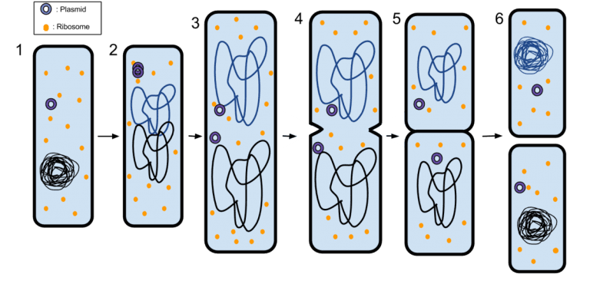
1. Binary Fission
a cell divides to produce two identical cells.
Each of these two cells has the potential to grow to the size of the original cell.
Ex. Prokaryotes, certain protozoans

Slide 21
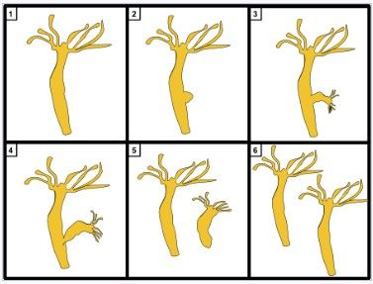
2. Budding
The formation of an outgrowth (or bud) from an organism
that is capable of developing into a new individual.
The outgrowth is genetically the same as the parent but relatively smaller.
It may stay attached or eventually split off from the parent.
Ex.certain bacteria, fungi, and certain asexual animals, such as hydra and corals.

Slide 22
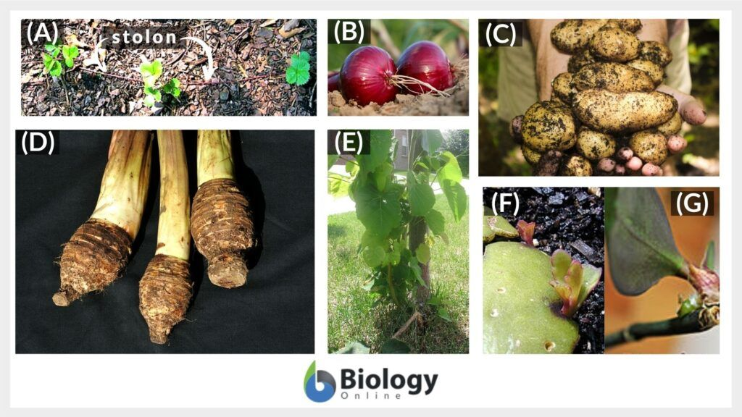
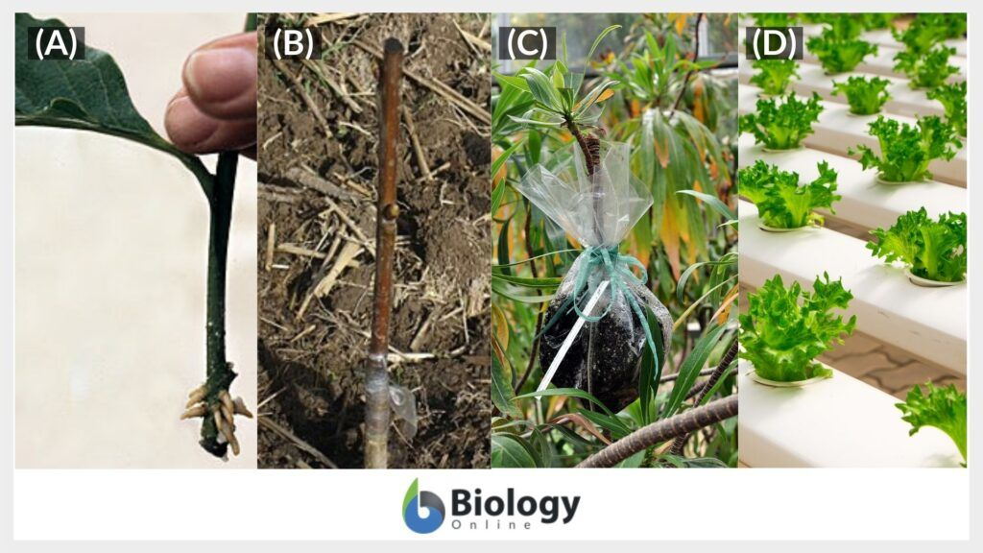
3.Vegetative Propagation
It is when a new plant emerges from vegetative parts, such as specialized stems, leaves, and roots.
Then, they form their own root system and grow.
Ex. those emerging from runners, bulbs, tubers, corms, suckers (root sprouts), and plantlets.

Slide 23
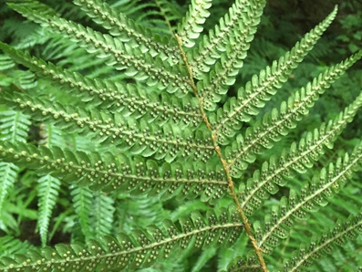
4. Spore Formation (Sporogenesis)
Involves spores.
Spores are dormant, reproductive cells and are thick-walled and highly resistant to various unfavorable conditions, like high temperatures and low humidity.
When the conditions are suitable, they germinate to give rise to new individuals.
Ex. Ferns
https://youtu.be/Mrphn1zOWaE

Slide 24
5. Fragmentation
parent organism breaking into fragments and
each fragment is capable of developing into a new organism
Human activity, predation, and other environmental factors may cause them to split into fragments.
Ex.fungi, molds, vascular and nonvascular plants, cyanobacteria, and animals (e.g. sponges, sea stars, planarians, and many annelid worms).
https://youtu.be/m12xsf5g3Bo

Slide 25
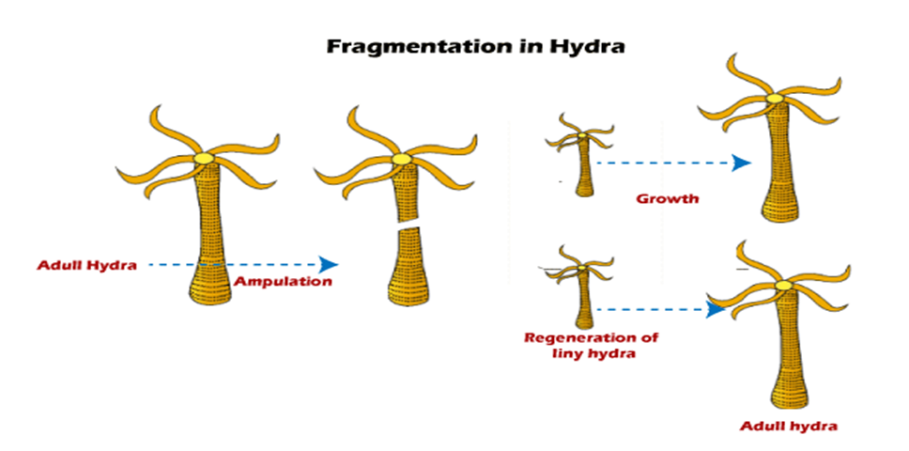

Slide 26
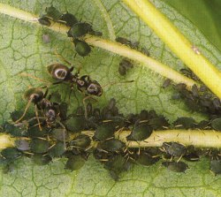
6. Parthenogenesis
offspring develops from a female gamete even without prior fertilization by a male gamete.
the females lay unfertilised eggs which hatch into females which also lay unfertilised eggs and so on
Ex: insects (ants, bees)

Slide 27
Sexual Reproduction
Fusion of male and female gamates is a must
The semen containing sperm cells is released by the male into the female’s reproductive organ
Only a single sperm would be able to fertilize a viable ovum
The haploid (n) sex cells form the diploid zygote that will next undergo mitosis to become an embryo
The embryo then develops organs and become a fetus inside the female womb.

Slide 28
The fetus receives nutrients inside the mother’s womb via an umbilical cord.
After the gestation period (usually, about 266 days), the female gives birth by pushing the fetus out of the birthing canal.
The newly born child, then, receives nutrition by lactation.
Postnatal care continues until the child becomes independent.

Slide 29
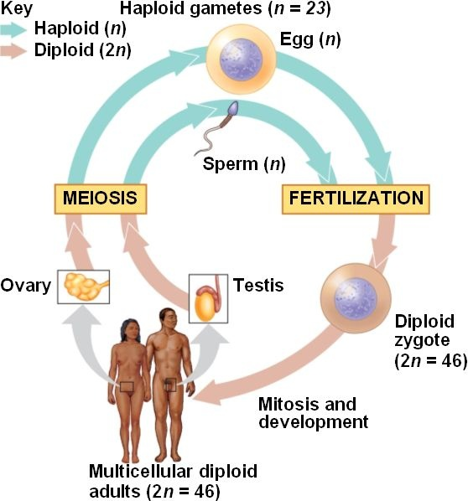

Slide 30
This is in contrast to asexual reproduction where an organism reproduces without involving gametes and the resulting offspring is a clone of the parent.
Nonetheless, sexual reproduction has the advantage over asexual reproduction in increasing genetic variation and expanding the gene pool.
Furthermore, it ensures that the chromosome number of a particular species will remain the same across generations.

Slide 31


